Slide 1
Goals, research questions, hypotheses, evaluating a paper, and all other things you also need to know when doing a master thesis in software engineering at Chalmers and University of Gothenburg in 2022
Lecturer: Richard Torkar
Slides partly donated by Dr. Mikael Svahnberg (BTH)

Slide 2
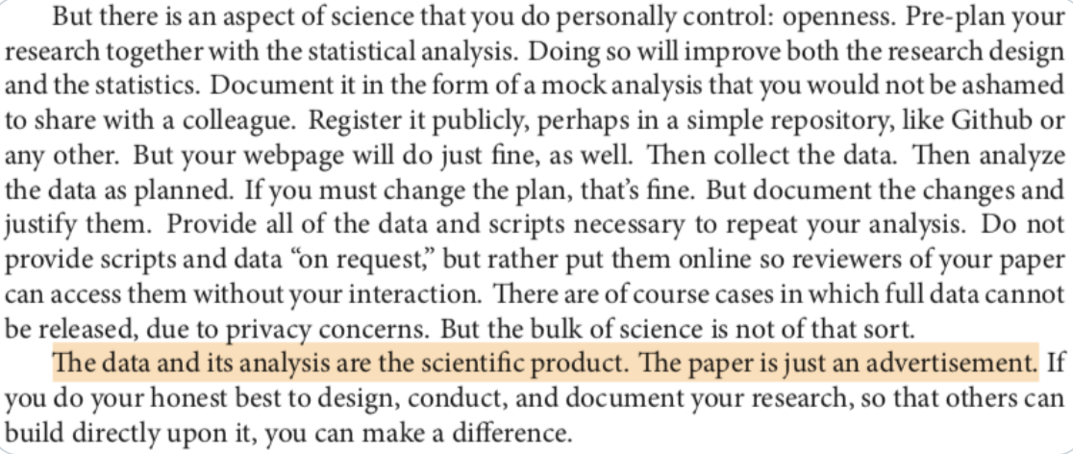

Slide 3
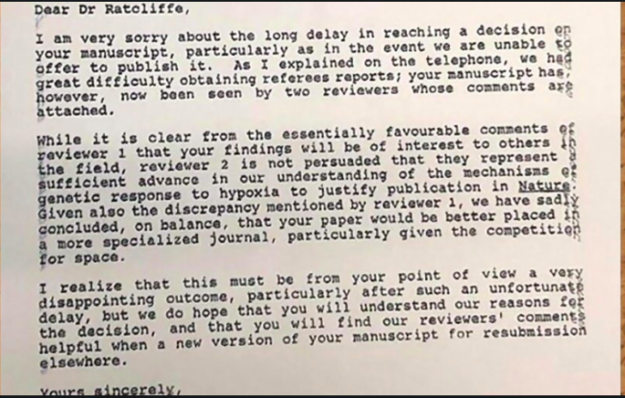

Slide 4
Overview of today’s lecture
Today not about research methods per se, rather meta things that also needs to be handled
How to formulate
Purpose of a research study (GQM)
Research questions
Hypotheses
Inclusion of theory in your papers…
How to assess publications/work that you find

Slide 5
Purpose

Slide 6
Purpose Statement
Your Aim, Intention, Drive, Reason
What are you going to do?
Why is this important?
Scientifically (Research community)
Economically (Financiers)
Used in
research proposal (Aims & Objectives)
research report (part of introduction)

Slide 7
Problem, Purpose, Question
Distinguish between these
“The problem is XXX”
“The purpose of this study is YYY, [in the context of XXX]”
“The research question is ZZZ”
will come back to research question later

Slide 8
Keywords
“purpose”, “intention”, “goal”
“discover”, “identify”, “evaluate”, “explore”, “compare”, “analyze”
Example:
The purpose of this study is to evaluate the use of Checklist-based Reading in the context of industry software development projects

Slide 9
The importance of the purpose statement
Sets the stage
Limits the research methodologies we are able to use.
The purpose of this study is to evaluate the use of checklist-based reading in the context of industry software development projects
... compare checklist-based reading with perspective-based reading ...
... identify the use of checklist-based reading ...

Slide 10
Examples of purpose statements
The purpose of this study is to
evaluate the performance achieved by six java JIT-compilers concerning arithmetic expressions.
elicit end-user viewpoints regarding the new calendar presentation, and analyse them for improvement suggestions.
compare Requisite Pro with DOORS with respect to which tool that best fit our current requirements engineering practices.
develop a simulation model of distance heating networks.
Notes:
Qualitative research is fluffy, not systematic,
It needs quantitative data
What type of analysis
They don’t say why it is important that they develop a simulation model
Think the target audience of the paper

Slide 11
GQM
The Goal, Question and Metrics (GQM) framework is used quite often in SE research
Develop a set of corporate, division and project business goals and associated measurement goals for productivity and quality
Generate questions (based on models) that define those goals as completely as possible in a quantifiable way
Specify the measures needed to be collected to answer those questions and track process and product conformance to the goals
Develop mechanisms for data collection
Collect, validate and analyze the data in real time to provide feedback to projects for corrective action
Analyze the data in a postmortem fashion to assess conformance to the goals and to make recommendations for future improvements

Slide 12
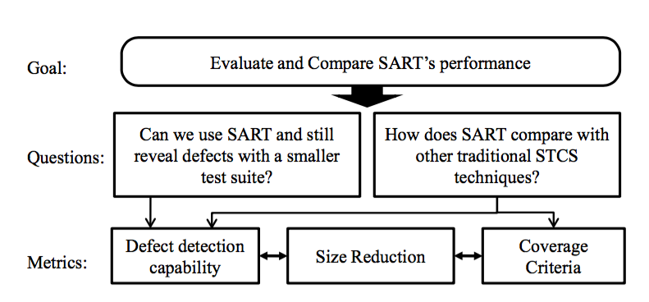
GQM example

Slide 13
Research questions

Slide 14
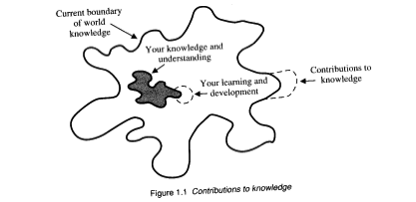
Research Question
In order to meet/reach your purpose, what questions do you need answered?
The RQs guide your work
But you may also change the research question based on how the work progresses
Answers to the research questions should contribute to the body of knowledge
[Dawson]
Notes:
Rq has been reformulated
It need to be transparent in the thesis, if you change rq, in the progress

Slide 15
Research Question
One or several main questions
A small number of sub-questions
Not always possible (or necessary) to state
Example: purely exploratory case studies
Avoid
Posing questions that cannot be answered
Asking questions that have already been answered (innovative height)

Slide 16
Examples of Research Questions I
Main Question
How can the performance of a container terminal (CT) be improved by using agent-based technologies?
Sub-Questions
What is the state-of-the art with respect to improving performance of CTs and can this be appropriately classified?
In order to increase efficiency in a CT, can agent-based technologies be used to control the operations?
How can agent technology be used to simulate and model the CT stakeholders?
How can simulation be used to evaluate berth allocation policies?

Slide 17
Examples of Research Questions II
Given a set of requirements on quality attributes for a system and a set of architecture candidates, which architecture candidate is the most appropriate, i.e. fulfils the requirements on quality attributes on the system best?
Is the perception of the strengths and weaknesses of different architecture candidates with respect to different quality attributes the same among a set of subjects?
Are software architectures perceived as supporting different quality attributes differently?
Notes:
2 is confusing, it is not clear
3

Slide 18
Hypotheses

Slide 19
Hypotheses
Statements (predictions) based on literature or own experience that is to be falsified in the project
Use statistical analysis to falsify hypothesis (frequentist approach vs. Bayesian approach)
Dawson’s recommendation: Either research question or hypothesis – not both. YMMW
Sometimes it helps to clarify what you are doing if you have both:
Not always possible to have both
Not always possible to have hypotheses
Notes:
Provevis aword use in maths

Slide 20
Hypothesis and null hypothesis
Null hypothesis
There are no underlying trends or patterns – differences are due to coincidence
Want to reject this
H₀: μ_{old} = μ_{new}
Alternative Hypothesis
What holds, for now, if you reject H₀
H₁: μ_{old} ≠ μ_{new}

Slide 21
Hypothesis testing
Type I error:
Test indicates pattern when there is no pattern (fp)
P(type-I-error) = P(reject H₀ | H₀ true)
Type II error:
Test indicates no pattern, when there actually is a pattern (fn)
P(type-II-error) = P(not reject H₀ | H₀ false)
Power:
probability that the test reveals a true pattern if H₀ is false
Power = P(reject H₀ | H₀ false) = 1-P(type-II-error)

Slide 22
Example of Hypothesis
Null Hypothesis: There is no difference in productivity between computer science students and software engineering students H₀ : Prod(CS) = Prod(SE)
Alternative hypothesis: H₁ : Prod (CS) ≠ Prod(SE)

Slide 23
Theory in papers and theses

Slide 24
Theory in papers/theses/etc.
A model of how things work
Explain
Predict
Examples of Theories
Mathematical Models
Conceptual Model
Causal Relation
Statements (like hypotheses)
Visual Model
A theoretical lens or perspective to guide your research
Notes:
Theory is not often use in software engineering

Slide 25
Theory and Aristotle
Induction
Explanatory
Principles
(Theory)
Observations
Deduction
Notes:
Induction deduction
We observe then explain what we have seen

Slide 26

Theory
Observations to build theory: Inductive
Theory to predict reality: Deductive
When do theories become Knowledge?
Withstand Challenges
Withstand Falsification
C.f. physics and Popper’s work
Notes:
Good book
Probability theory (as well)
No perfect model but there are useful models
As a summer reading

Slide 27
Where and how to include theory
Introduction?
Literature review/related work?
After research question/Hypotheses?
Separate section?
Nowhere?
Theory as a result of study?
What theories do you need to include and explain?
1+1=2?
Computer science/software engineering Basics?
Explicit theory upon which you build or focus your work?

Slide 28
Assessing published work

Slide 29
Assessing the quality of literature
What is research?
Published in Scientific Journals/Conferences
Decided by reviewers (researchers)
Peer reviewing
ACM DL, IEEE Xplore, Springer, Elsevier, Wiley
Thus: no objective definition of research
Notes:
Start reading some papers to get some idea

Slide 30
Why is it important to evaluate published research publications?
Your research is based on other referenced work
If that work is bad then your work is likely to be (regarded as) bad
Critical reviewing and thinking is fundamental for research
Ability to assess other researchers’ work helps you to assess the quality of your own work.

Slide 31

Assessing the quality of research publications
Indirectly
Type of publication (is it peer reviewed?)
Check references in publication (have they done their homework?)
Check references to the publication (are other people using this as a source?) Careful…
Directly
Read the paper (see the paper on Canvas)
Is the publication applicable to your work?
Does it make sense?

Slide 32
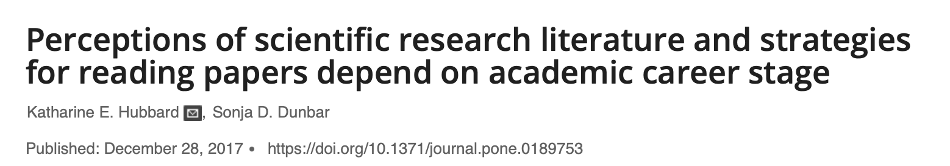
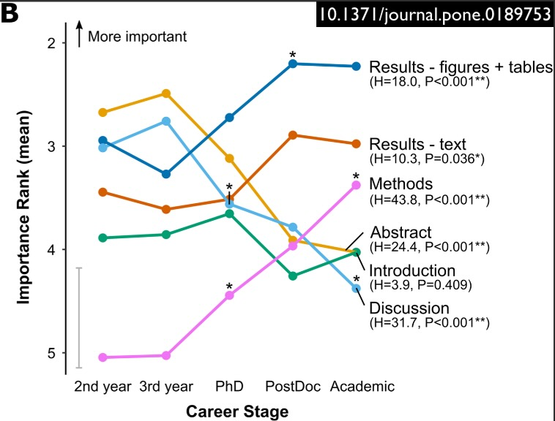
Notes:
Results – figures, tables, text
Methods
Not interested in discussion of what the paper found, reader has its own opinion

Slide 33
Peer Reviewing for (most) Research Journals
Anyone can submit an article/paper to a research journal (or conference or workshop).
Each journal has a specification of what types of research papers it is intended for.
A chief editor or an editorial board decides whether to accept the papers for publication or not.
To assist the board they “employ” a number of referees (normally 2-3) for each submitted article.

Slide 34
Peer Reviewing for Research Journals
Referees are typically “known names”, and/or previously published in the journal.
Referees are very often anonymous!
Sometimes the authors are anonymous too (double blind review)
Referees give detailed comments and recommendation of acceptance or rejection
It can be regarded as a form of voting system on what is high quality research
Potentially problematic for new areas of research and interdisciplinary research?
What if you catch the referee on a bad day?

Slide 35
Referees: Assessing the quality (“The task of the Referee”, A.J. Smith)
Clearly stated purpose?
Appropriate for the journal?
Significant/useful goal?
Relevancy
Valid method/approach?
Correct execution of approach?
Correct conclusions?
Presentation (understandable)?
Anything to learn for the reader?
Other Instructions from journal/conference

Slide 36
Example: Instructions to Referee
EASE Review Form
Paper Number:
Reviewer Name:
First Author:
Overall Assessment
Strong Accept / Weak Accept / Weak Reject / Strong Reject
Reasons for assessment (Comments not visible for authors):
Appropriate for conference: (Scope of paper matches call for papers)
High / Medium / Low
Originality: (For non-replication studies)
High / Medium / Low
Validity of research method:
High / Medium / Low
Importance
High / Medium / Low
Suitable for Journal Publication
Yes / No
Comments for authors:

Slide 37
Hierarchy of publications

Slide 38
Hierarchy of Publications
Academic Journals
Standardised Peer Review Process
Who is the publisher (may have other relevant journals)?
Detailed and specific (might be tough when new to an area)
Rather recent results available
Books
Often comprehensive
Might be outdated
No standardised reviewing
Are there references to the book?

Slide 39
Hierarchy of Publications: ctd.
Conference Proceedings
Quality varies between conferences
Check acceptance ratio
No standardised way of reviewing
Established conferences have good quality
Typically very recent work
Theses (dissertations)
In some way reviewed
Varies in Quality
Often a good starting point for research in a new area

Slide 40
Hierarchy of Publications: ctd.
Workshops
Unfinished ideas, as well as research results.
May have a reviewing process in place
Some workshops are well established and rank higher than conferences – check for references to the workshop
Manuals (of software)
Often not (scientifically) reviewed. May contain many errors.
Purpose is to sell – not critically review.
Others (company reports, RFCs, white papers, newspaper articles, etc.)

Slide 41
Using a publication I
Be your own referee
purpose
appropriateness
significant goal
valid method/approach
correct execution of approach
correct conclusions
presentation
anything to learn for the reader

Slide 42
Using a publication II
What kind of article?
review, theoretical, case study, experiment etc.
What can you gain?
ideas, techniques, etc.
Is the author recognised in the area?
What is the contribution?
Can it support your work?
Does it fit within the context?
Context of itself and your work
Are the conclusions supported by logic reasoning, the results, and the discussion?

Slide 43
Using a publication III
Are there contradictions with the work of others (in method and/or conclusions)?
Can you distinguish opinions from facts?
Do you agree? Does it make sense?
What references are used?
Can you use the results, methods, ideas, etc. in your research?

Slide 44
Using a publication IV
Does it motivate your work by pointing out where further research is needed?
Does it contain interesting shortcomings or problems that you can “fix” in your project?
How does it present research questions and hypotheses? Can you learn from that?
Are there techniques that you can use?
Algorithms, statistical analysis, etc.

Slide 45
Writing a Literature Review
Motivate the need for research
Is it original research, or has it already been done
Starting point for other researchers (improves understandability)
Present the foundations for your research
Helps you in your project
Identify what you do not need to do yourself
Used to refine your research question
Relevant! Not a history of the world, the universe, and of computer science.

Slide 46
Tips for Literature review
Always record full reference to the material you find
Keep a record (or database) of your references, including simple classification
Make short summaries of the papers
Use conceptual models of how the literature is connected
Consider using special purpose software for organising your literature (e.g. Bibtex and Endnotes)

